Slide 1

Richard M. Nixon
M stands for Milhous
A Sujebertz Corporation Masterpiece

Slide 2
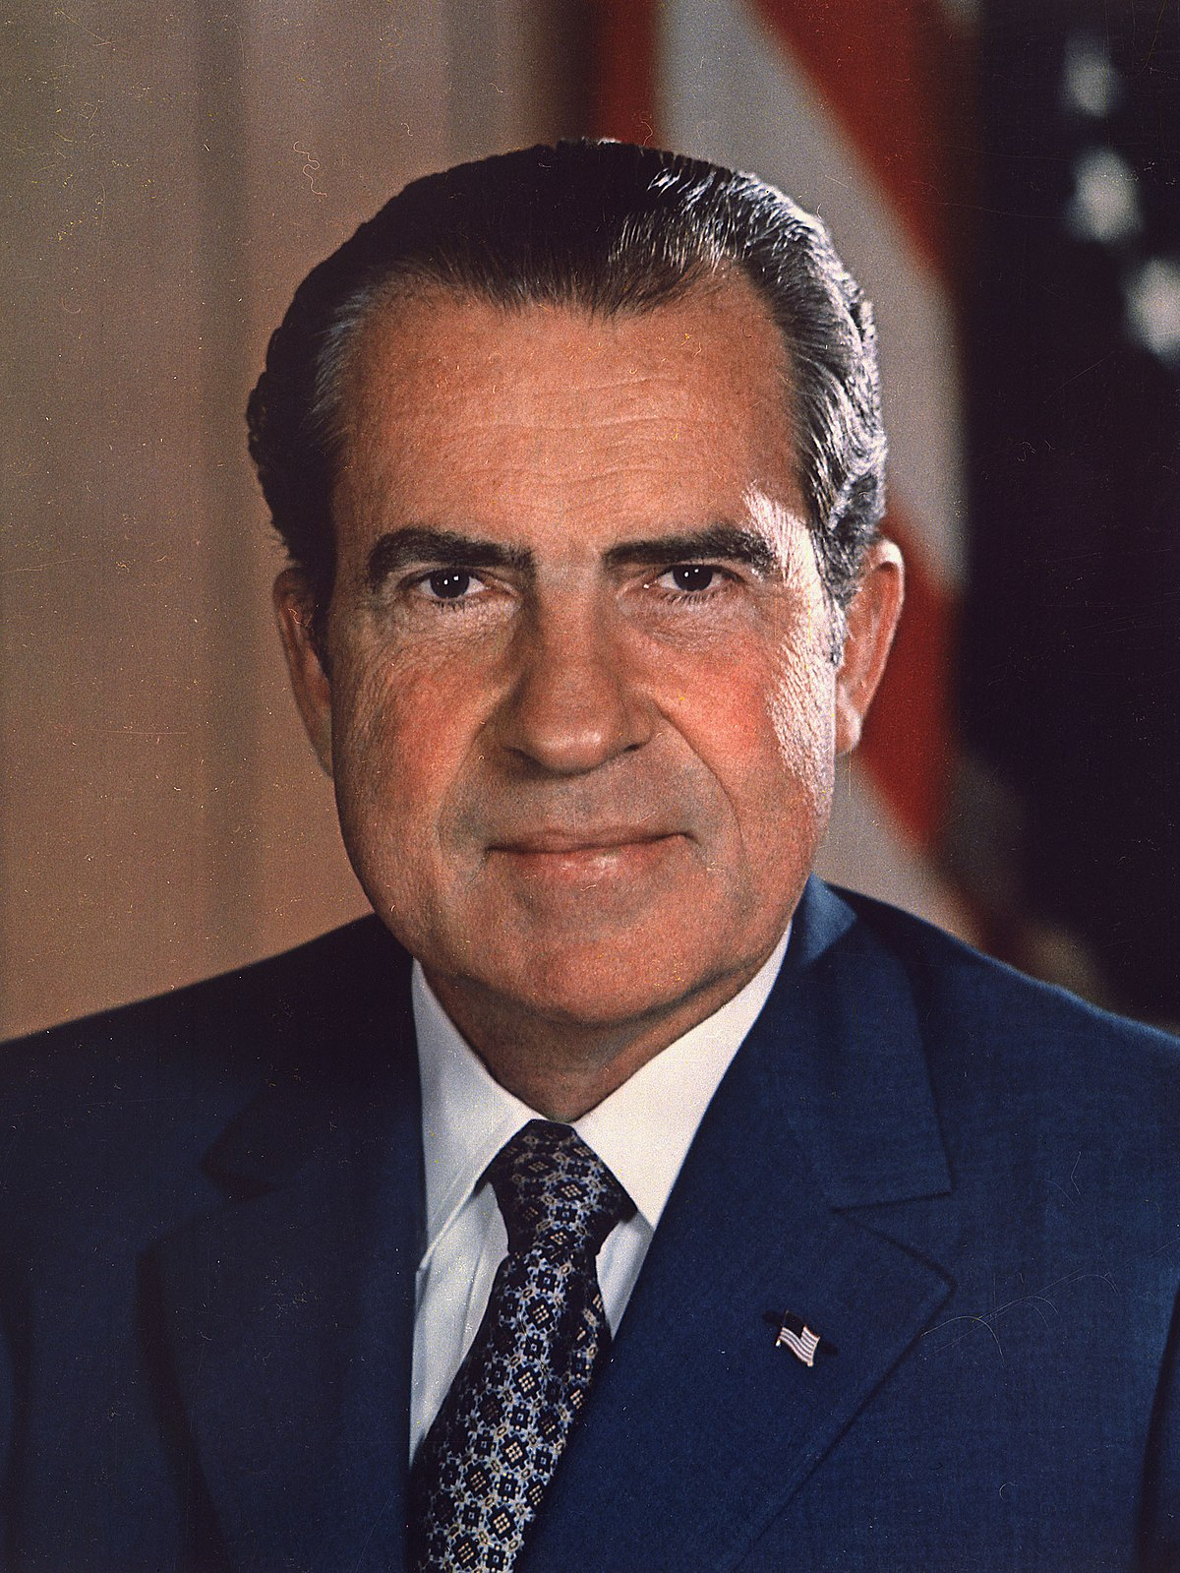
Characteristics
Born: 1913
Death: 1994
37th President between 1969 – 1974
Political Party: Republican
Occupation: Political Lawyer

Slide 3
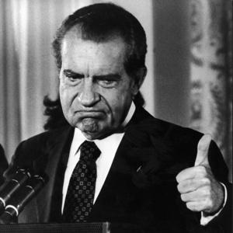
Facts
Nixon was a lieutenant commander in the Navy during World War II.
He was also an outstanding law student.
Ended U.S. involvement in Vietnam War
The first moonlanding happened during his period
Talented Diplomat ( Improved Relations with Soviet Union and China )

Slide 4
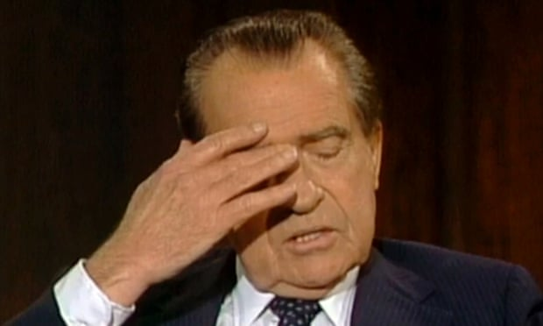
Controversies
Resigned from office due to the Watergate scandal
Accused of abusing the powers of the presidency
Was impeached by the House of Representatives for obstruction of justice

Slide 5
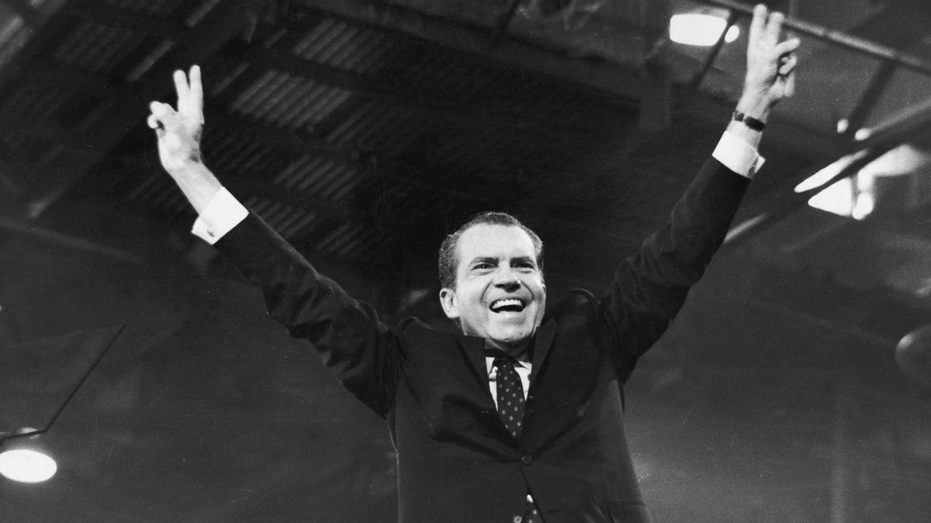
Thanks for your attention

